Slide 1
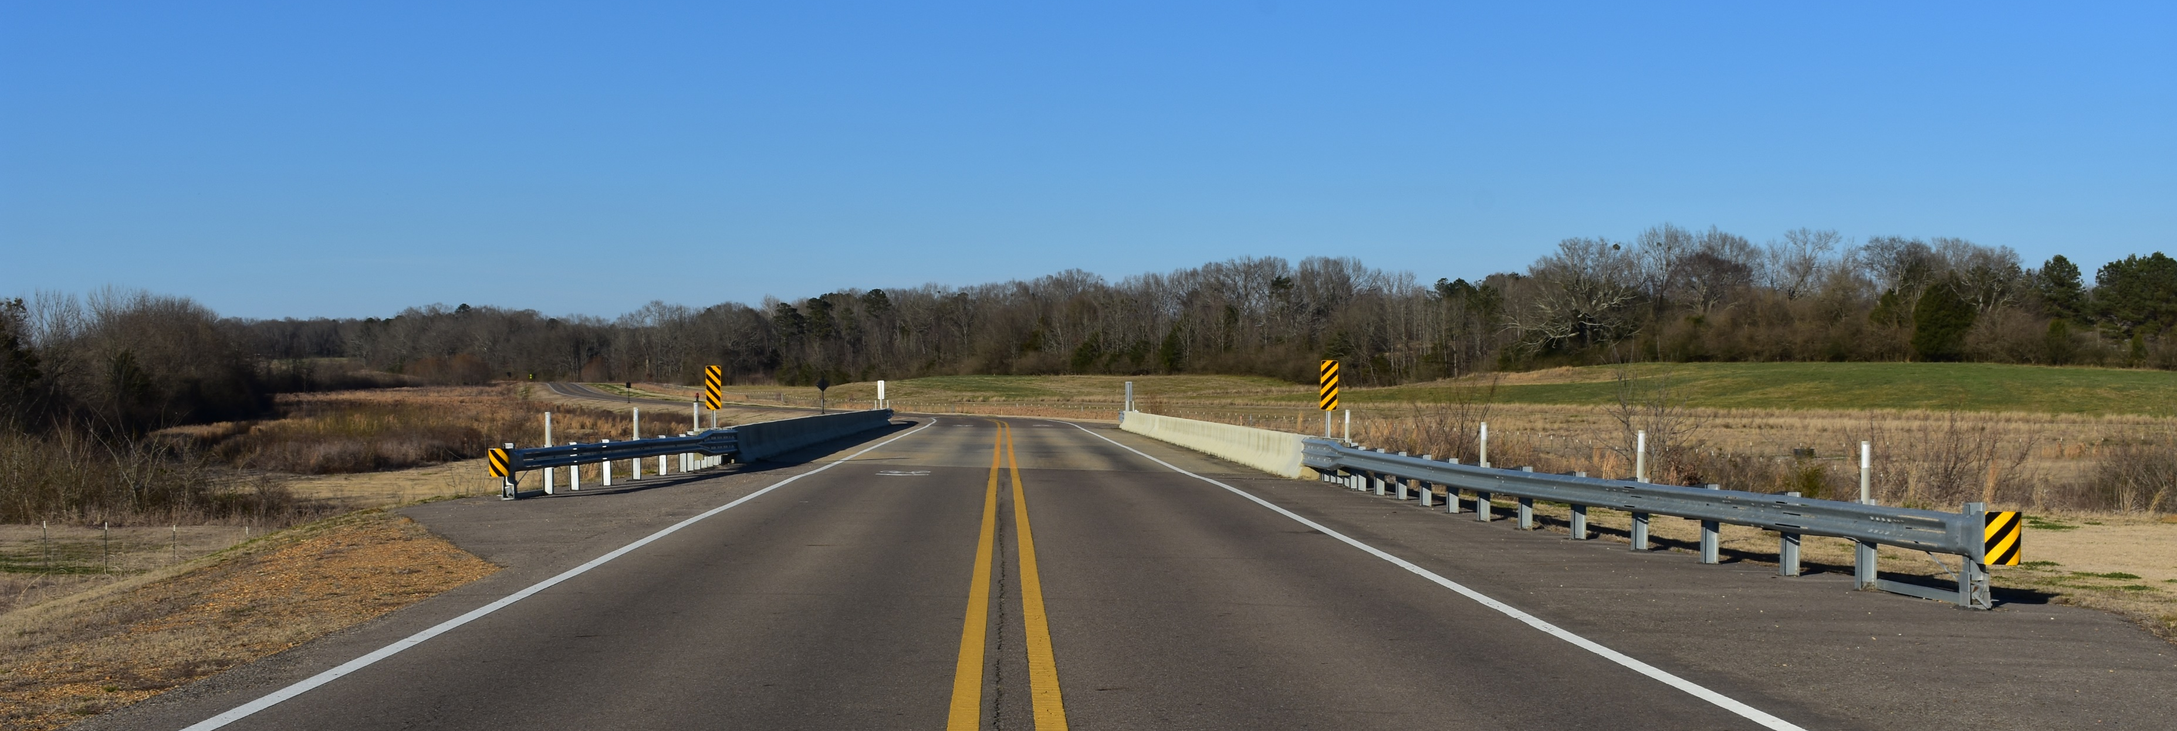
WRECKS
Wireless Roadside Emergency Collision Kinetic Sensor

Slide 2
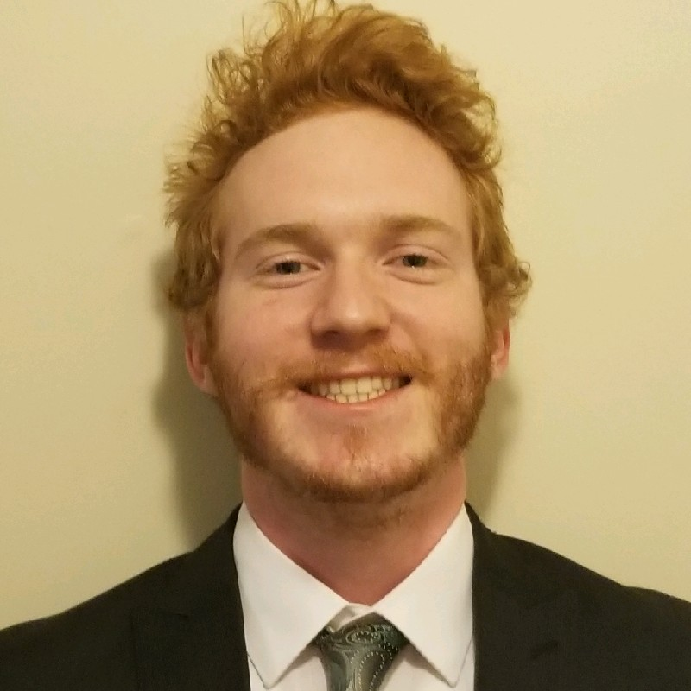
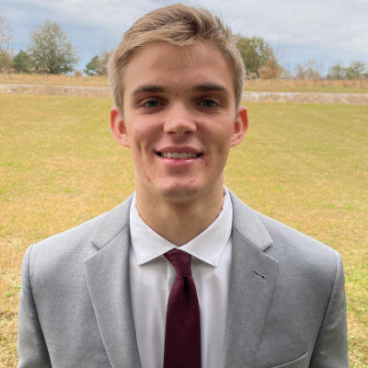
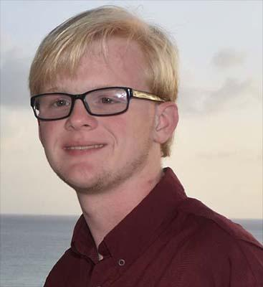
Meet The Team
Ajaya Dahal
Banepa, Nepal
Computer Engineering
Team Lead
Software Communication Lead
Zachary Sahnger
Hernando, MS
Computer Engineering
Software Functionality Lead
Joey Westerfield
Mobile, AL
Electrical Engineering
Power Distribution Lead
Walker Thames
Buford, GA
Electrical Engineering
Hardware Communication Lead
Will Clark
Madison, MS
Electrical Engineering
Sensor Lead

Slide 3
Team Advisor
Dr. Ryan Green
Electrical and Computer Engineering
Academic Research/Fields of Interest
Smart-City Communication
Internet of Things
Optically Transparent Communication Devices
Wireless Medical Telemetry
Notes:
Will

Slide 4
External Advisor
Neal Wise
CFO Atwood Fence Company
BBA, Mississippi State University, 2008
JD, University of Mississippi Law, 2011
Notes:
Will

Slide 5
OVERVIEW
Problem
Solution
Approach
Evaluation
Constraints
Moving Forward
Notes:
joey

Slide 6
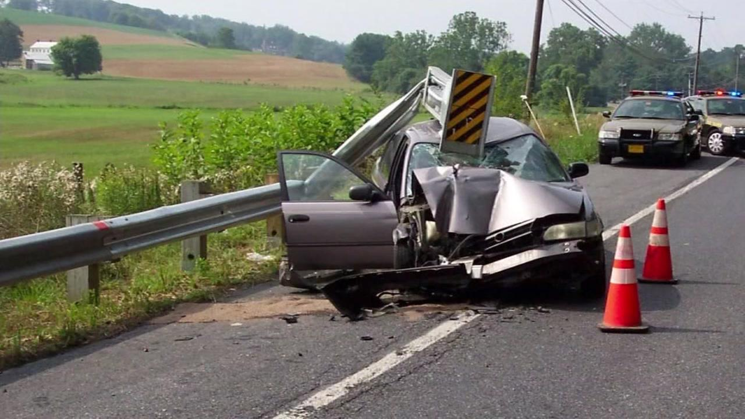
Problem
Terminal end sections (TES) are everywhere
TES are constantly being destroyed and replaced
Too many resources spent on monitoring and replacing
[1]
Notes:
Walker

Slide 7
Solution
Remote sensor to monitor guardrail status
Collect crash data
Send real-time notifications to customers
Notes:
Zach

Slide 8
Technical Constraints
Name | Description
Battery Life | The battery lasts two weeks without charging.
GPS Data | WRECKS uses a GPS that is accurate within 8 meters.
Sensor Data | The IMU sensor has a margin of error of 1%.
Sampling Rate | The device samples IMU data at 50 Hz.
Communication | WRECKS alerts customers to damaged safety assets via web/Android applications, email, and MMS messaging.
Latency | Notifications from WRECKS reach the customer no later than thirty seconds after a crash occurs.
Notes:
1-3 AJ, Walker

Slide 9
Practical Constraints
Type | Name | Description
Safety | Notifications | The device can contact authorities in the case of a crash.
Environmental | Waterproofing | The device survives storms and flooding.
Environmental | Temperature | The device functions in both hot and cold severe weather conditions.
Economic | Price | The device is priced less than one hundred dollars.
Sustainability | Lifespan | The device is designed to last five years.
Manufacturability | Attachment | WRECKS is attached to the guardrail using adhesive pads.
Manufacturability | Size | The entire device is no larger than 100 mm wide, 100 mm long, and 50 mm tall.
Notes:
Joey from Safety to Environmental remaining zach

Slide 10
Engineering Standards
Specific standard | Standard document | Specification / application
IP Rating | IP-67 [2] | WRECKS meets the specifications for an IP-67 rating.
Communication | FCC 01-158 [3] | WRECKS uses the LoRa protocol, which utilizes the 915 MHz ISM band.
Communication | IEEE Std 802.16m [4] | WRECKS also uses the 4G/LTE network for the communication.
Global Positioning System | IEEE 2030.101-2018 [5] | WRECKS app utilizes GPS technology to pinpoint the detected collision.
Notes:
Will

Slide 11
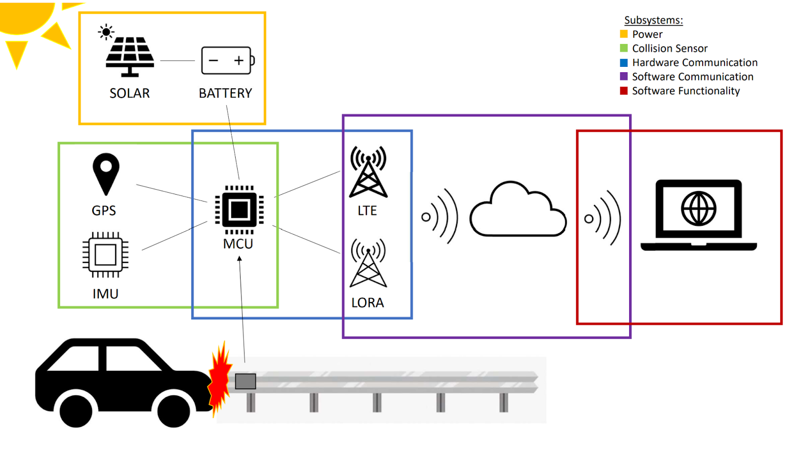
System Diagram
Notes:
Walker

Slide 12
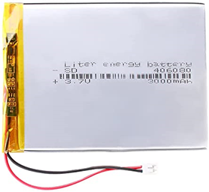
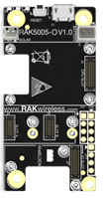
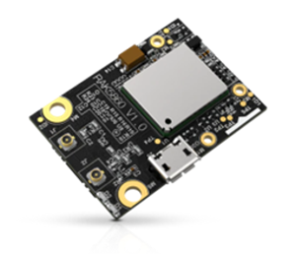
Hardware
RAK 4631
SUNYIMA
Liter 406080
RAK 5005-O
RAK 1904
RAK 5860
[6] - [11]
Notes:
Zack

Slide 13
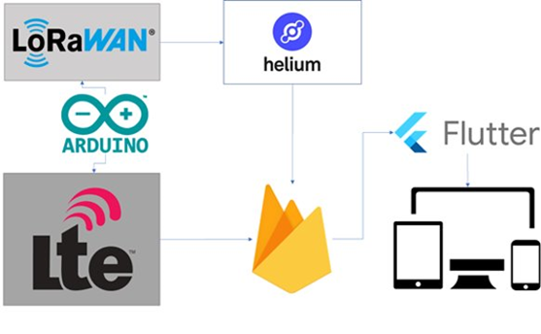
Software
[12] - [16]
Notes:
AJ

Slide 14
Evaluation
Notes:
Joey

Slide 15
Battery Life
Notes:
Joey

Slide 16
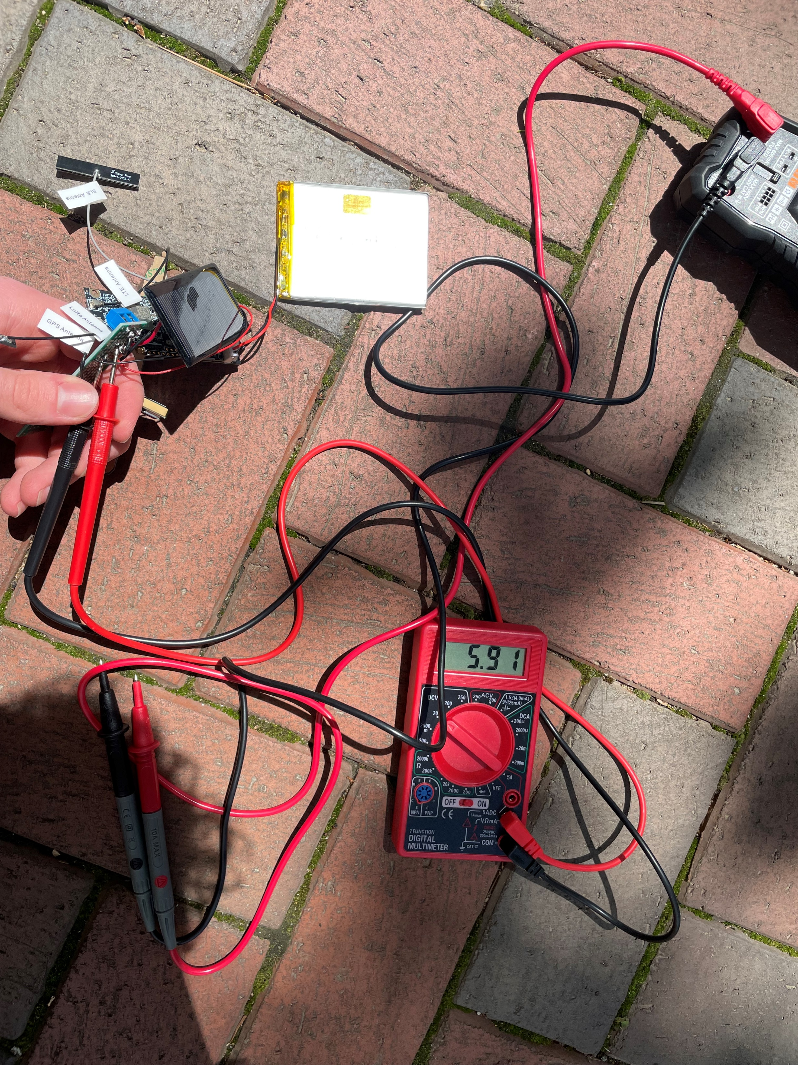
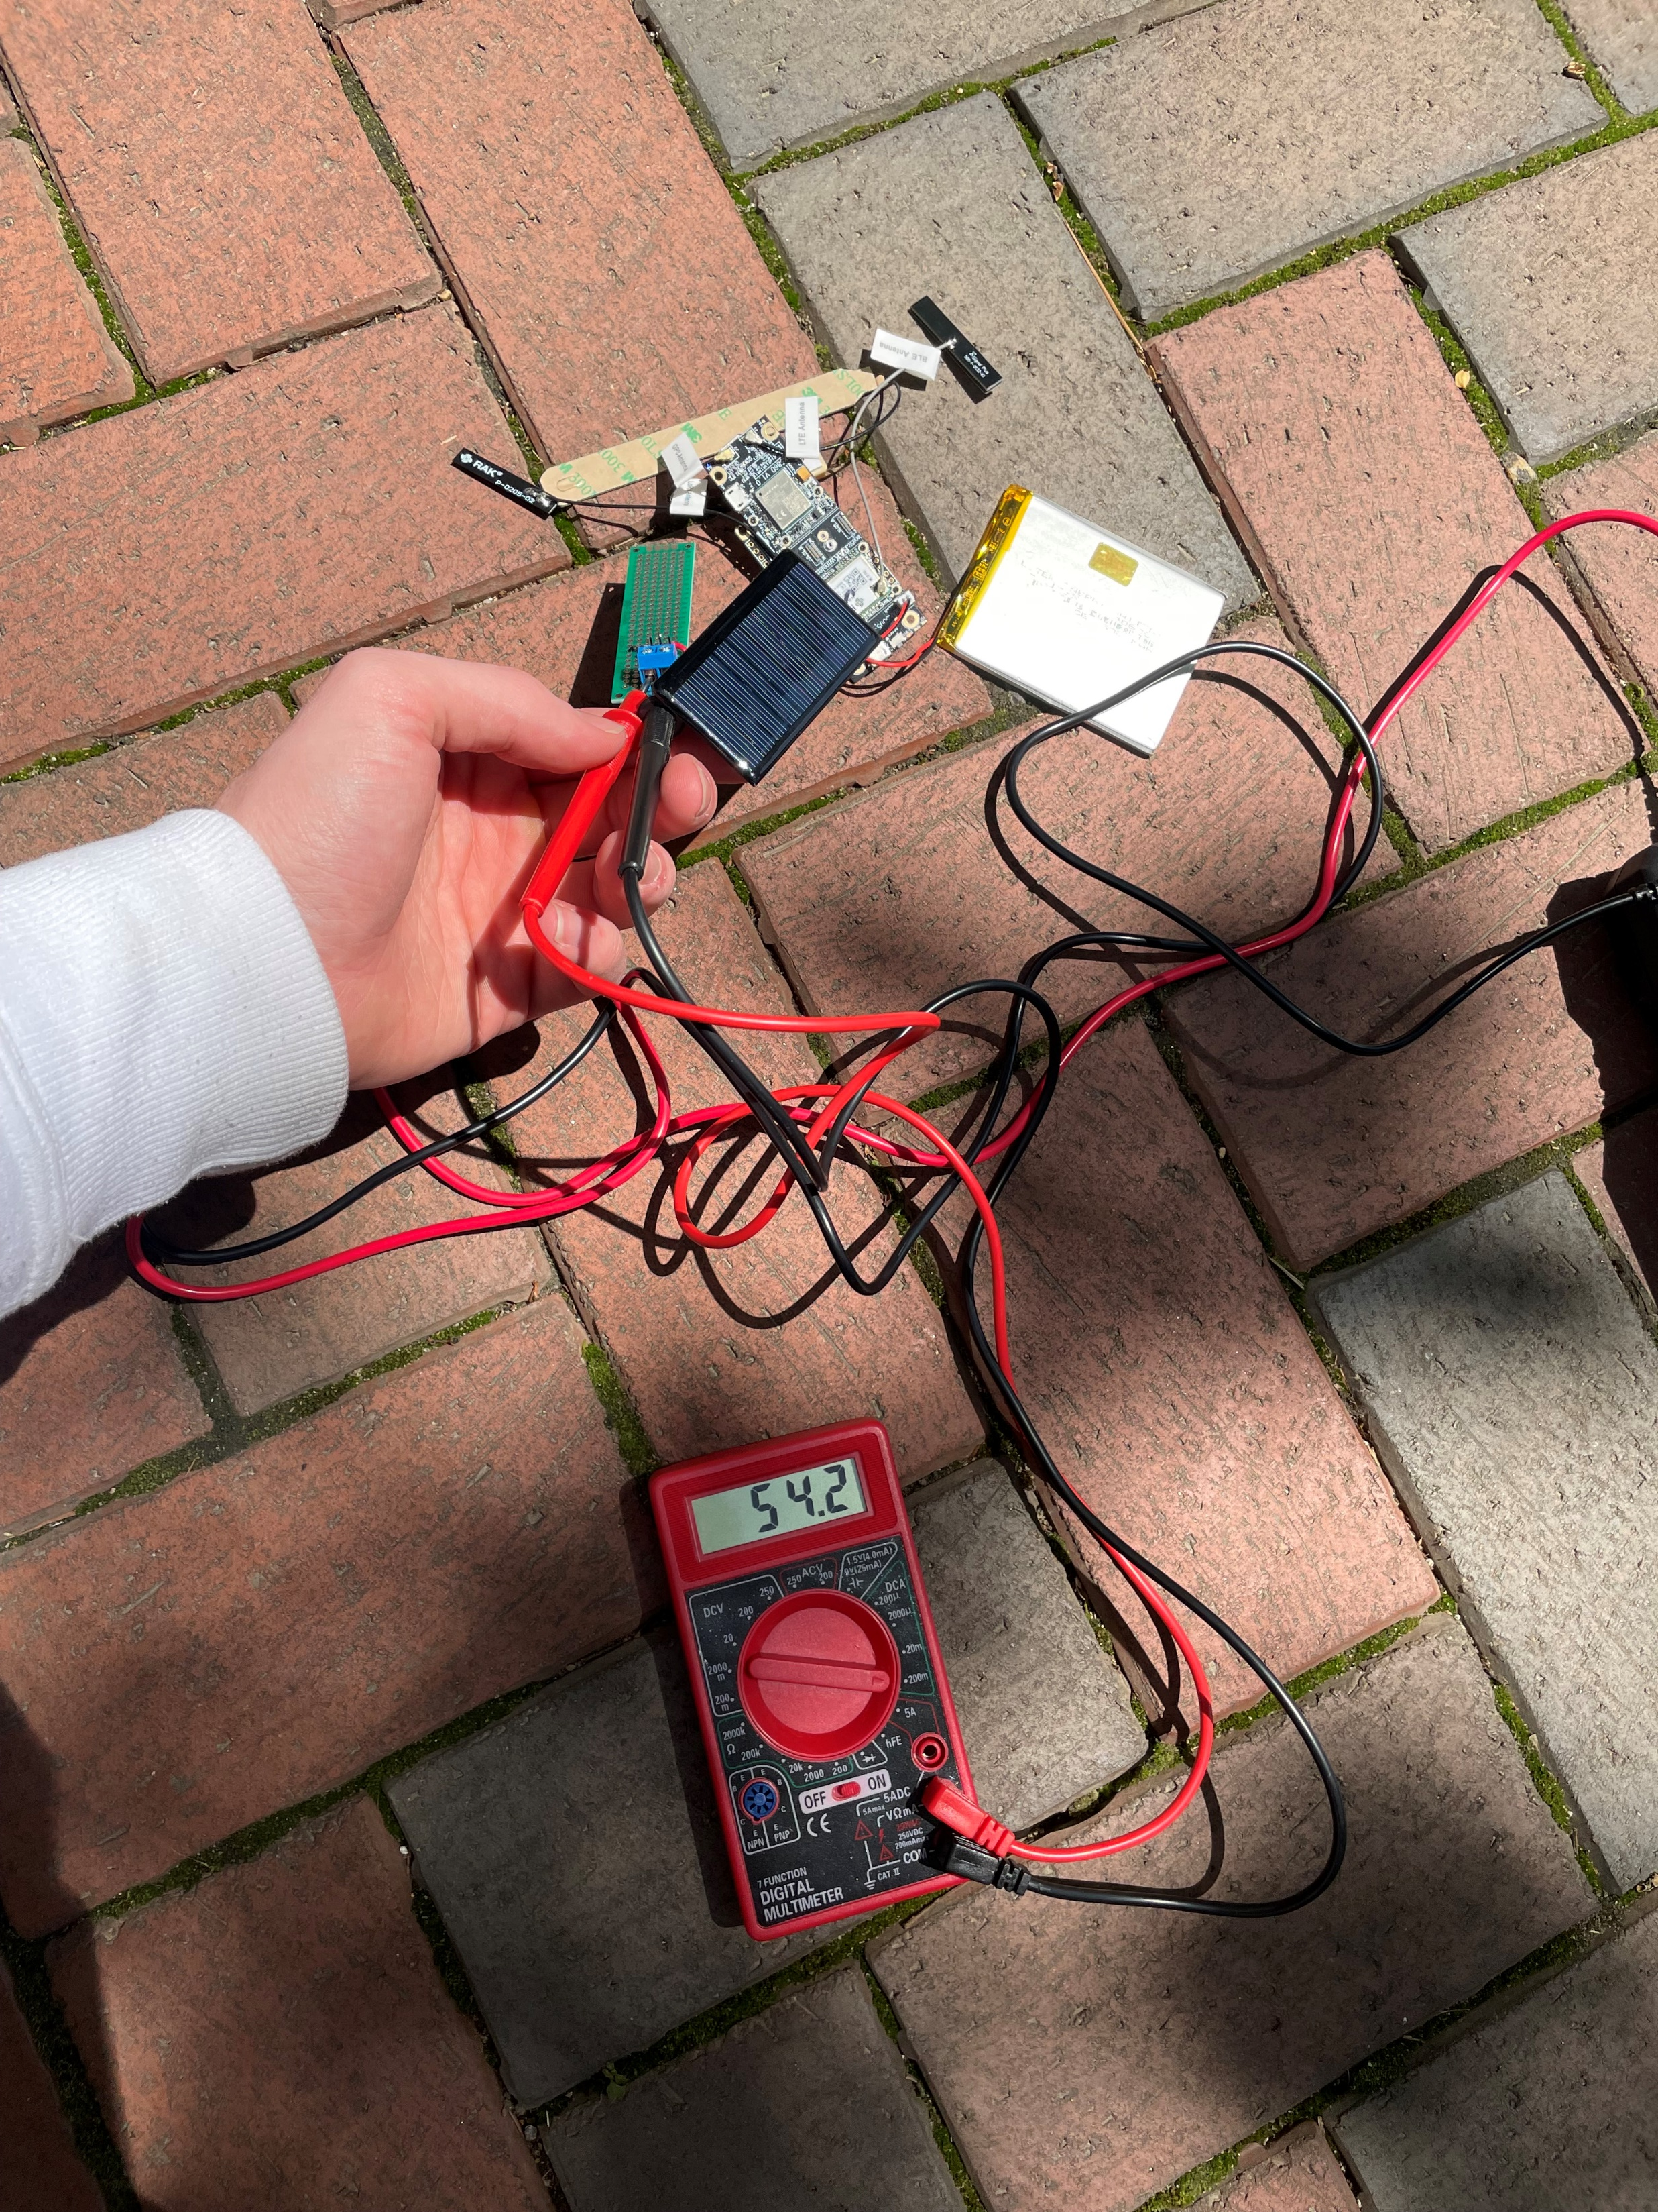
Power testing
Ammeter
Solar Panel/Battery
Board Terminals
Voltmeter
Notes:
joey

Slide 17
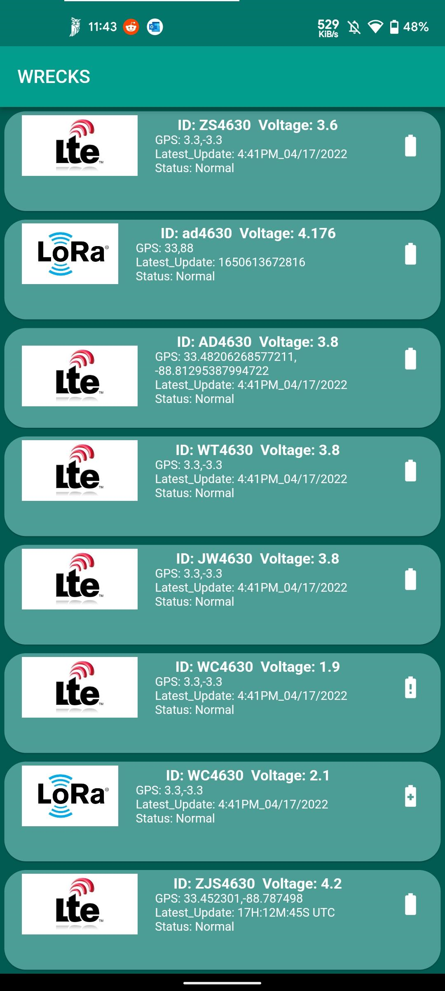
GPS Data
Notes:
Will

Slide 18
Sensor Data
Notes:
Walker

Slide 19
Sampling Rate
64 MHz on-chip oscillator Microcontroller
18.55 us results in ~54 Hz sampling rate
Notes:
AJ

Slide 20
Cellular Signal Strength
RakWireless included LTE antenna
Location | Mississippi State University Campus | Downtown Starkville, MS | 5.4 miles west of Starkville, MS
Channel ID | 5110 | 5110 | 5110
LTE RSSI | -68 | -42 | -76
LTE SINR | 93 | 238 | 110
RSSI (dBm) | 23 | 31 | 19
PulseLarson 5150 (LTE)
Location | Mississippi State University Campus | Downtown Starkville, MS | 5.4 miles west of Starkville, MS
Channel ID | 5110 | 5110 | 5110
LTE RSSI | -67 | -41 | -69
LTE SINR | 105 | 225 | 112
RSSI (dBm) | 21 | 31 | 22
Notes:
Zack

Slide 21
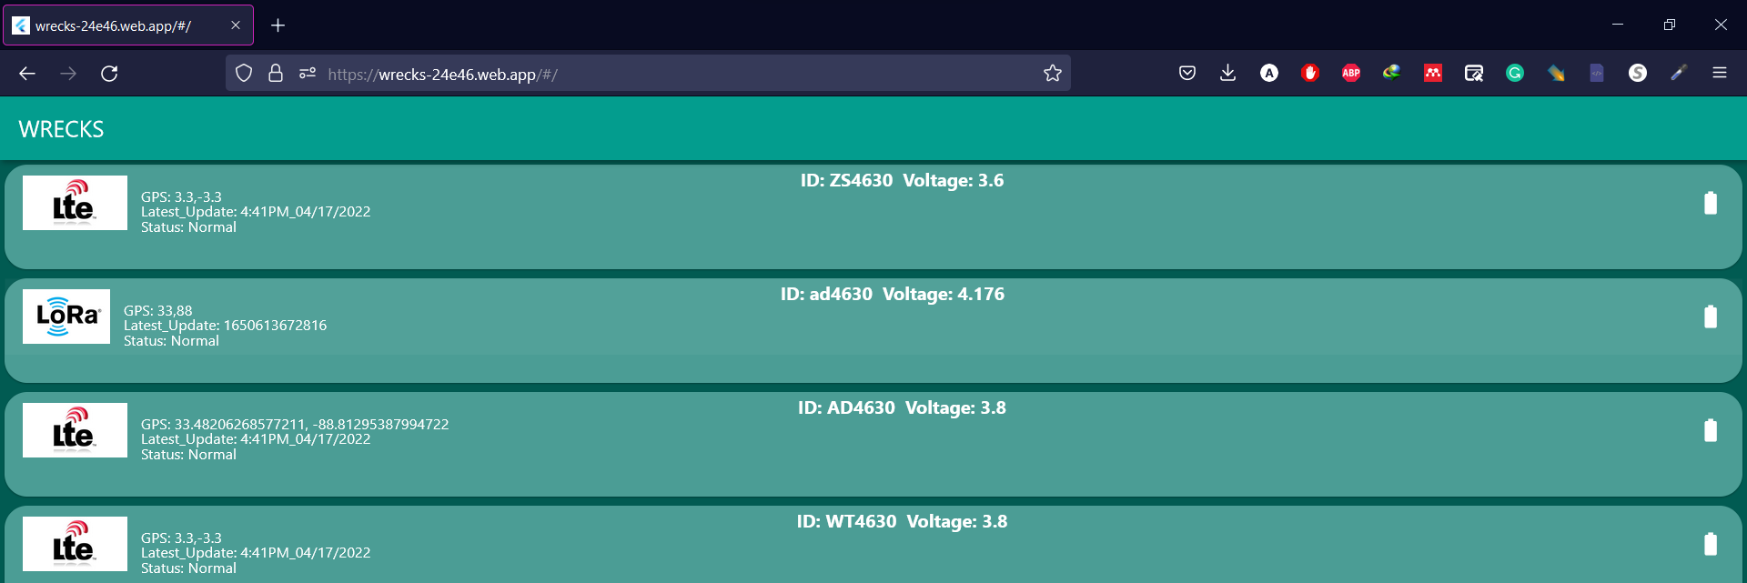
Communication
Webapp
Notes:
AJ

Slide 22
Communication
Email Notification
Android App
Notes:
AJ

Slide 23
Latency
Needs to send message in less than 30 seconds
Notes:
Will

Slide 24
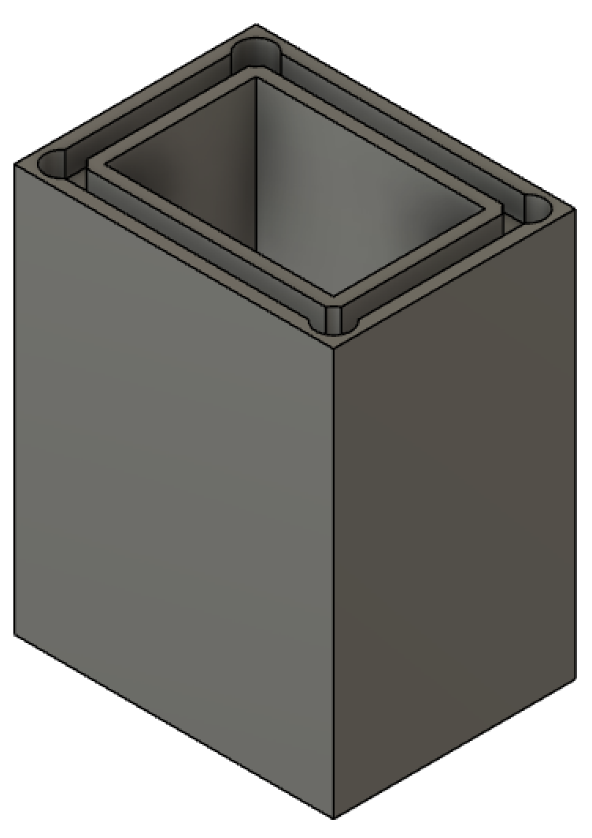
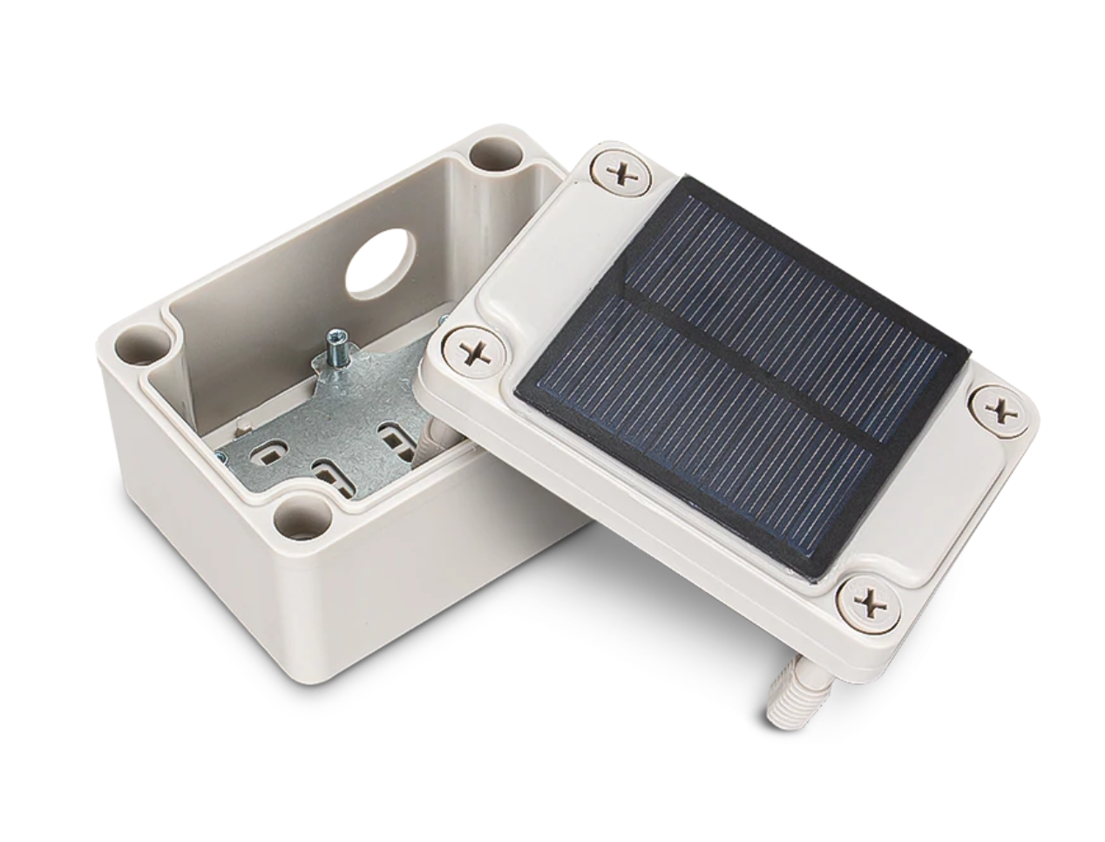
Enclosure
[17]
Notes:
Walker

Slide 25
Cost
Product | Cost (USD)
RakWireless RAK5005-O [9] | $9.99
RakWireless RAK4631 [10] | $17.99
RakWireless RAK5860 [20] | $30.00
PulseLarson W5150 [22] | $14.34
RakWireless RAK1904 [31] | $3.30
SUNYIMA Solar Panel [39] | $1.60
Liter 406080 Lipo Battery [33] | $10.99
Total | $88.21
Notes:
joey

Slide 26
TEST Status
Test​ | Status​
Battery Life​ | Complete
GPS Data​ | ​Complete
Sensor Data​ | Complete
Sampling Rate​ | Complete
Communication​ | Complete​
Latency​ | Complete​
Cost​ | Complete​
Enclosure​ | Incomplete

Slide 27
Moving forward
Demo Day
Senior Design II
System Optimization
Enclosure
Develop an excellent product!

Slide 28
REFERENCES
[1] Go.com, 2022. Available: https://cdns.abclocal.go.com/content/kgo/images/cms/1502726_1280x720.jpg (Accessed Jan. 26, 2022).
[2] “IP rating - Enviromed.” [Online]. Available: http://enviromed.ca/documents/IP%20Rating%20Chart.pdf. [Accessed: 24-Feb-2022].
[3] “Federal Communications Commission.” Accessed: Apr. 05, 2022. [Online]. Available: https://transition.fcc.gov/Bureaus/Engineering_Technology/Notices/2001/fcc01158.pdf
[4] IEEE 802.16m System Requirements. Institute for Electronics and Electrical Engineers, 2008. [Online]. Available: https://ieee802.org/16/tgm/docs/80216m-07_002r7.pdf [Accessed 24-Feb-2022].
[5] “IEEE Guide for Designing a Time Synchronization System for Power Substations,” IEEE 2030.101-2018, pp. 1–118, Jul. 2018, doi: 10.1109/IEEESTD.2018.8421294.
[6] “RAK4631 | nRF52840 SX1262 | Module for LoRaWAN,” RakWireless.com, 2022. [Online]. Available: https://store.rakwireless.com/products/rak4631-lpwan-node (Accessed Mar. 08, 2022).​
[7] “RAK5005-O | WisBlock Base Board,” RakWireless.com, 2022. [Online]. Available: https://store.rakwireless.com/products/rak5005-o-base-board (Accessed Mar. 08, 2022).
[8] “RAK5860 | BG77 | NB-IoT Interface Module,” RakWireless.com, 2022. [Online]. Available: https://store.rakwireless.com/products/rak5860-lte-nb-iot-extension-board (Accessed Mar. 08, 2022).​
[9] “RAK1904 | LIS3DH | 3-axis acceleration sensor,” RakWireless.com, 2022. [Online]. Available: https://store.rakwireless.com/products/rak1904-lis3dh-3-axis-acceleration-sensor (Accessed Mar. 06, 2022).
[10] “Liter 3.7V 3000mAh 406080 Lipo Battery Rechargeable,” Amazon.com, 2022. [Online]. Available: https://www.amazon.com/3000mAh-Battery-Rechargeable-Lithium-Connector/dp/B09FPQ62FM/ref=sr_1_2?crid=2ZB1688QC1W4A&keywords=rechargeable+3.7+v+battery&qid=1646769236&refinements=p_n_feature_five_browse-bin%3A23559008011&rnid=23559001011&s=hpc&sprefix=rechargeable+3.7+v+battery%2Caps%2C92&sr=1-2 (Accessed Mar. 08, 2022).

Slide 29
References
[11] “SUNYIMA 10Pcs 5V 60mA Epoxy Solar Panel Polycrystalline Solar Cells for Solar Battery Charger DIY Solar System Kits,” Amazon.com, 2022. [Online]. Available: https://www.amazon.com/AOSHIKE-Polycrystalline-Battery-Charger-2-67x1-45inch/dp/B0736W4HK1/ref=sr_1_4?keywords=SUNYIMA+Solar+Panels&qid=1646772250&s=lawn-garden&sr=1-4 (Accessed Mar. 08, 2022).
[12] “Flutter - Beautiful native apps in record time,” Flutter.dev, 2019. [Online] Available: https://flutter.dev/ (Accessed Mar. 08, 2022).
[13] “Firebase,” Firebase.com, 2018. [Online]. Available: https://firebase.google.com/ (Accessed Mar. 08, 2022).
[14] “Cellular Connectivity for the Internet of Things | Hologram,” Hologram.io, 2022. [Online]. Available: https://www.hologram.io/ (Accessed Mar. 08, 2022).
[15] “Helium & LoRaWAN,” Helium.com, 2022. [Online]. Available: https://www.helium.com/lorawan (Accessed Mar. 08, 2022).
[16] “Arduino - Home,” Arduino.cc, 2018. [Online]. Available: https://www.arduino.cc/ (Accessed Mar. 08, 2022).
[17] “RAKBox-B2 Enclosure with solar panel,” RAKwireless Store. https://store.rakwireless.com/products/rakbox-b2-enclosure-with-solar-panel (accessed Apr. 26, 2022).

Slide 30
THANK YOU!

